Slide 1
Relation Extraction of Biomedical Text
Under Guidance of
Professor Carlos Rojas
Neeharika Yeluri (neeharika.yeluri@sjsu.edu)
Pranav Chellagurki( pranav.chellagurki@sjsu.edu)
Rahul Raghava Peela(rahulraghava.peela@sjsu.edu)
Sai Prasanna Kumar Kumaru (saiprasannakumar.kumaru@sjsu.edu)

Slide 2
Introduction
Exploring the rapid increase in biomedical research papers; over a million new papers published annually.
Emphasizes the need for advanced tools to extract and synthesize information from the vast amount of data.
Introduces the use of Large Language Models (LLMs) and Knowledge Graphs as innovative solutions for biomedical Natural Language Processing (NLP).
Aims to enhance biomedical NLP capabilities, making it possible to extract significant relationships from texts and discover insights into gene-disease interactions and drug efficacy.

Slide 3
Related Work
Reviews early statistical NLP models leading up to advanced deep learning approaches including transformers and LLMs.
Highlights the specific evolution of biomedical NLP, noting the adaptation of general NLP tools for biomedical applications, such as BioBERT.
Discusses previous challenges in the field, particularly the lack of effective tools that integrate both high-level computational models and scalable knowledge architectures like knowledge graphs.
Points out that while general-purpose LLMs are increasingly used, their application in specialized fields like biomedicine remains complex due to unique vocabulary and contextual demands.
Concludes with the observation that recent works have begun to bridge these gaps through specialized datasets and model tuning but more focused efforts are needed.

Slide 4
Datasets and Processing
GAD Dataset: 53,300 relations describing gene-disease associations, labeled as positive (1) or negative (0) relations.
GAD: "Mutations in the BRCA1 gene can cause breast cancer" labeled as 1.
EU-ADR Dataset: 3,550 relations focused on drug, disorder, and gene targets, similarly labeled for positive or negative relationships.
EU-ADR: "LRP5 genetic variants as possible susceptibility factors for osteoporosis" labeled as 1.
Structured input template with masked entities and binary relation indicators to reduce ambiguity and enhance learning consistency.

Slide 5
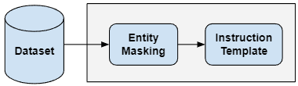
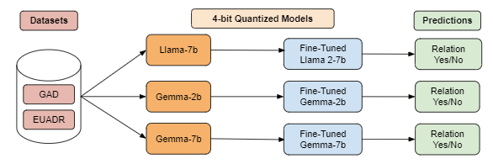
Methodology

Slide 6
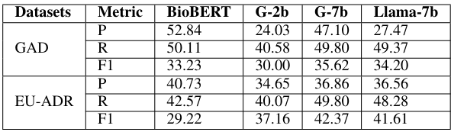
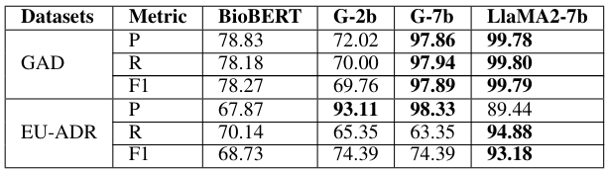
Experiments and Results
Experiments without Fine tuning
2. Experiments with Fine tuning
Notes:
Coming to experiments and results section
Initial tests showed poor performance without fine-tuning, confirming its importance and necessity for fine tuning
Performance Insights after fine tuning:
BioBERT excelled particularly on the EU-ADR dataset, outperforming Gemma- 2b on Recall.
This is due to EU-ADR’s specialized vocabulary posed challenges
Llama2-7b surpassed all the base models on both datasets, demonstrating its superior handling of complex relations with 99% Precision, Recall, F1 score

Slide 7
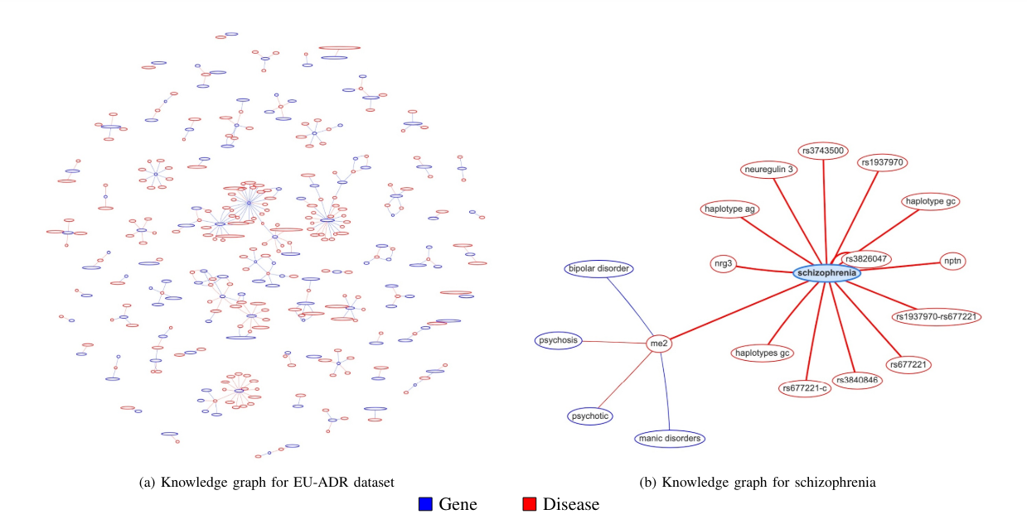
Knowledge graph and Multi-hop connections
Notes:
These graphs Demonstrates a visualization of the EU-ADR relations. The colors indicates the disease as red and genes as blue. On the left we see the complete graph with genes and diseases and their relations.On the right , the figure demonstrates the sub-graph of a specific gene/disease.with many connections that researchers can glean from visualizing the relations.

Slide 8
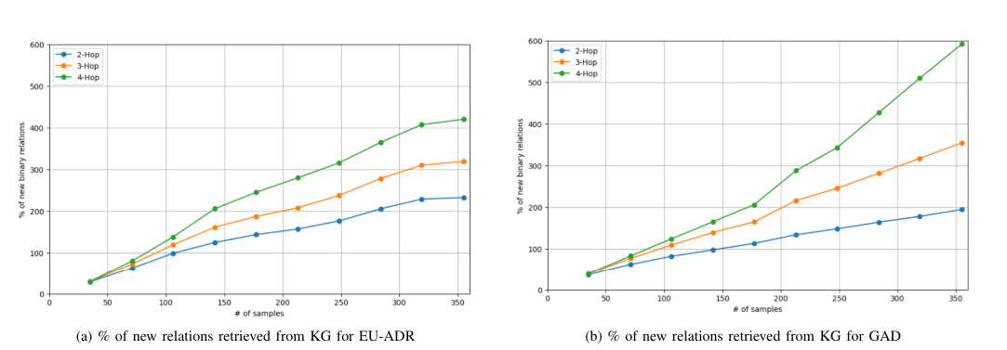
Knowledge Graph Insights
Notes:
Insights from multi hop experiments in Knowledge graph
Multi-hop searches helps us identify additional relations, with 2-hp,3-hp 4-hop searches revealing two to fourfold increment.
The GAD dataset showed even greater enhancements, underscoring the knowledge graph ability to uncover extensive new connections.

Slide 9
Challenges and Future Work
Model Size vs. Tuning Depth:
Smaller models offer computational efficiency and faster training, ideal for limited-resource settings.
Larger models have superior reasoning abilities due to extensive neural architectures but often lack comprehensive fine-tuning.
Challenges with Large Models:
Inadequate handling of specialized vocabularies due to partial fine-tuning, a significant issue in fields like biomedicine where terminology evolves quickly.
Future Focus on Fine-Tuning:
Comprehensive fine-tuning of larger models, especially their tokenizer components, to enhance their ability to process complex datasets fully.
Innovative Solutions to Reduce Computational Load:
Develop more efficient algorithms and explore advanced hardware solutions to manage and reduce the computational demands of large models.
Adaptive Tokenization Techniques:
Implement adaptive tokenization that adjusts to the specialized vocabularies of different domains, ensuring large models maintain effectiveness across varied datasets.

Slide 10
THANK YOU

